Slide 1
Elections Update
2024 Presidential Primary

Slide 2
Data Points – Exactly 37,755 Registered Voters at 10:30am today
December 20 – Mailed Approx. 8,000 Absentee Ballot Applications
December 29 – Mailed Approx. 12,000 Ballot Selection Forms
January 11 – Mailed Approx. 5,000 Polling Place Change Notices (Precinct 2 & 7)
January 11 to 17 – Received & Recorded Exactly 6,716 Applications & Forms
January 11 to 17 – Prepared & Issued Exactly 6,716 Ballots
January 18 – Sent Approx. 5,000 Emails, 5,000 Phone Calls, and 5,000 Text Messages Reminders to Voters about Ballot Selection
January 18 – Mailed Exactly 524 letters to voters who did not provide email/phone.
January 22 – Mailed Exactly 6,716 Ballots

Slide 3
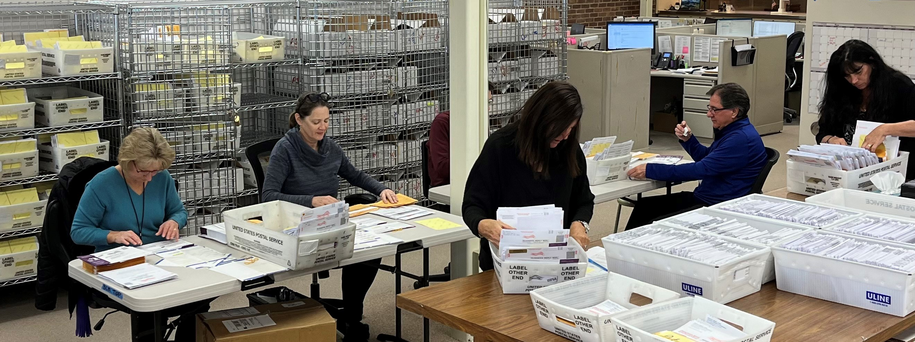
Absentee ballot team members
Hard At Work

Slide 4
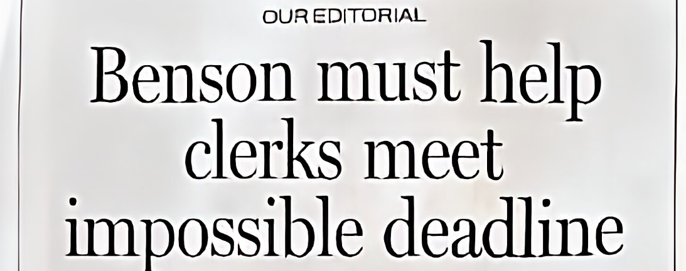
Accomplished Mission Impossible
Per Detroit News Editorial
January 18, 2024

Slide 5
Vote Your Way – New Options for 2024
  Permanent Ballot List
  Permanent Absentee List – Sunsetting
  Early Voting
    Bloomfield Twp. Library
    Saturday, February 17 – 25
    8:30am to 4:30 pm, except Thursday Noon to 8:00pm
  Early AV Processing & Tabulating
    February 23, 24, and 26
  Tabulate Your AV Ballot During Early Voting or on Election Day

Slide 6
Important Deadlines – Presidential Primary
February 1 (on or about) We will mail a proposal-only ballot to any permanent mail ballot voter who has not selected a presidential primary ballot
February 16 @ 5pm– Last day to spoil a returned absentee ballot and receive a new one in person
February 16 @ 5pm– Last day to spoil an unreturned ballot and receive a new one by mail
February 17 to 25 – Early voting at Township Library
February 23, 24, and 26 – Early absentee ballot processing and tabulating
February 26 @ 4pm – Last day to spoil an unreturned ballot and receive a new one in person
February 27 – Election Day
March 1 @ 5pm – Deadline to cure mismatched signature on ballot envelope

